Slide 1

Welcomes You!
Alternatives Public Workshop
Tampa Interstate Study (TIS) Supplemental Environmental Impact Statement (SEIS)
and
Northwest (Veterans) Expressway Design Change Re-evaluation
May 21 & 23, 2019
Notes:
The Florida Department of Transportation or FDOT welcomes you to the Alternatives Public Workshop for the Supplemental Environmental Impact Statement of the Tampa Interstate Study. This workshop also covers a design change re-evaluation for the Northwest Expressway (now known as the Veterans Expressway).

Slide 2
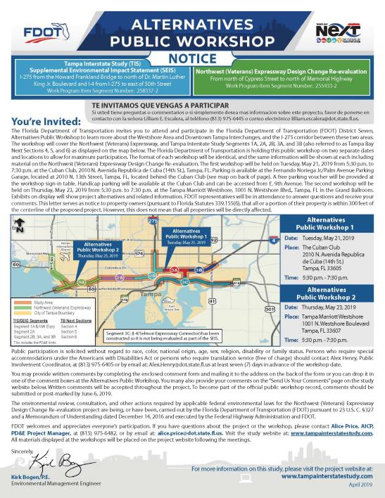
Project Website
For Project Information Visit:
www.tampainterstatestudy.com
Notes:
For your convenience and future information, FDOT created a public website for this project. You can go to www.Tampainterstatestudy.com for additional project information. Materials from this public workshop and other project details will be posted there.

Slide 3
Workshop Zones
1
Study Introduction - TIS History
TIS SEIS Overview
What Problems Are We Trying to Solve?
Preliminary Study Findings
Photo Simulations and 3D Visualizations
Opportunities for Connectivity and Transit
Northwest Expressway Concept Plans
TIS SEIS Concept Plans
Tampa Bay Next Program and Adjacent Projects
2
3
4
ZONES
5
6
7
8
9
Notes:
This is a complex project, and we have a lot of information on display tonight. To help you navigate our public workshop, we divided the room into nine zones. At the top left corner of each slide, there is a reference to one of the nine zones. Not only do we have printed exhibits and physical documents, we also have smartboards and TV’s to help you visualize the project alternatives. FDOT staff is also available to help walk you through the zones and explain all of the information.

Slide 4
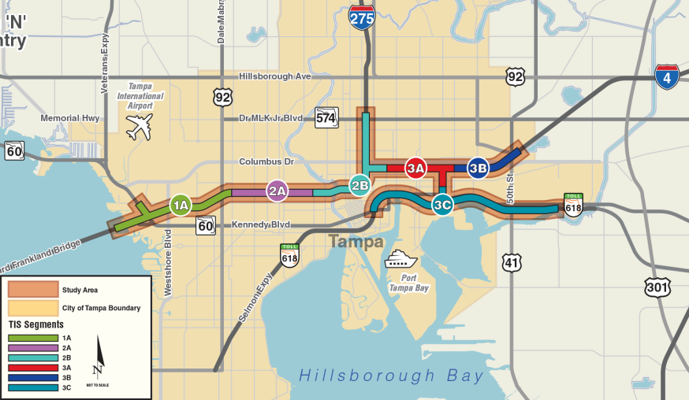
1
TIS SEIS Study Area
The original Tampa Interstate Study EIS was split into segments.
The SEIS analysis uses those same segments.
From west to east they are:
Westshore Interchange:
Segments 1A, and a portion of 2A
Westshore to Downtown Tampa:
Segment 2A
Downtown Tampa Interchange:
Segments 2B and 3A
Downtown Tampa to 50th Street:
Segment 3B
I-4/Selmon Expressway Connector:
Segment 3C (already Constructed)
Notes:
To get started, Zone 1 provides a study introduction and brief history of the Tampa Interstate Study, including how the project, was originally segmented, which is a little different than the TB Next Segments.
The Westshore Interchange falls within Segment 1A and a portion of 2A. The Downtown Interchange is within Segments 2B and 3A. Segment 3C is the I-4/Selmon Expressway Connector, which has already been constructed.

Slide 5
1
How did we get here?
1985
- 1989
1997 & 1999
2000 –
2015
2015
2016
2017
2017 - 2019
May 2019
Tampa Interstate
Study (TIS) Master Plan
Tampa Interstate Study (TIS)
Final EIS (FEIS) Records of Decision (RODs)
Reevaluate and Construct Outer Roadways on I-275, I-4, and the Selmon Connector
Tampa Bay Express (TBX) Master Plan
TBX
Reset
Launched Tampa Bay Next and started Supplemental EIS (SEIS)
Intense Public Engagement including Public Workshop
Public Workshops
and Draft Documents Available
Notes:
But how did we get here? The TIS started back in the late 1980’s with a master plan that led to environmental document approval by the Federal Highway Administration in the late 1990’s. Some of the project has been built, including widening I-275 in West Tampa, I-4 in East Tampa/Ybor, and the I-4/Selmon Expressway Connector. In 2015, the FDOT began to study the feasibility of tolled express lanes on Tampa Bay interstates. After public concerns, the FDOT re-set their focus and expanded the conversation to include transit, bicycle/pedestrian, and smart technology. Tampa Bay Next was launched in 2017 and FDOT began the Supplemental EIS.

Slide 6
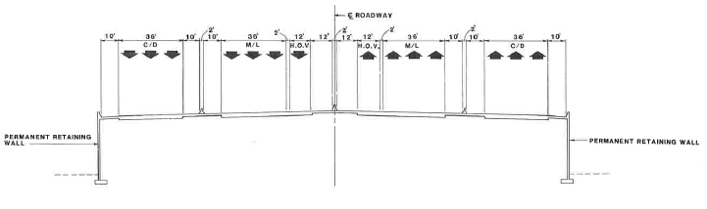
1996 TIS FEIS Long-Term Preferred (Non-Tolled)
1
Adds non-tolled express lanes
in each direction
Does not provide direct express
lane access to Westshore or
Downtown Tampa
Provides transit envelope
in the median
No longer meets current
design standards
Does not meet current purpose and need
High-Occupancy Vehicle/ TRANSITWAY
GENERAL USE
EXPRESS LANE
EXPRESS LANE
GENERAL USE
Notes:
The original 1996 Long Term Preferred Alternative included non-tolled express lanes in each direction, shown in the green, along with the general use lanes in yellow, and a High-Occupancy Vehicle/Transitway in the median. The primary differences in the original and the build alternatives that are under evaluation now, is that the original concept did not provide direct access to Westshore or Downtown Tampa and the express lanes were not tolled.

Slide 7
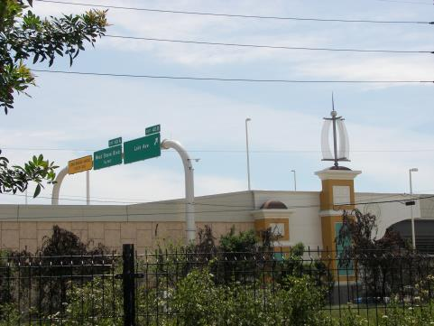
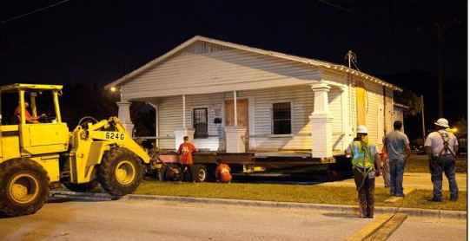
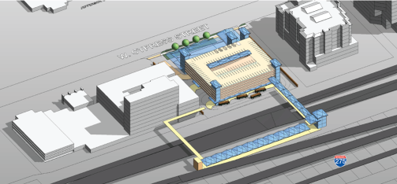
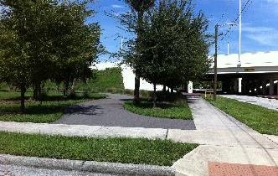
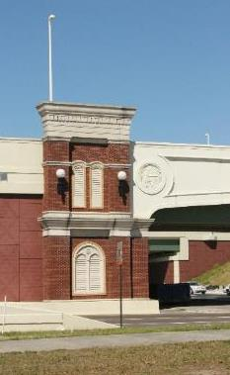
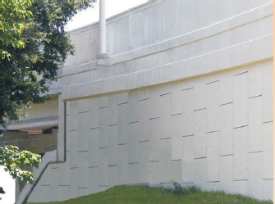
Urban Design Guidelines
1
Relocating Historic Structures
Original Commitments
Urban Design Guidelines
Noise Barriers
Multimodal Center
Historic Preservation
Tampa Heights Greenway
Urban Design Guidelines
Tampa Heights Greenway
Bicycle and Pedestrian Facilities
Multimodal Center
Construction Techniques
Pedestrian Connectivty
HART North Terminal*
Noise Barriers
Parks and Recreation Facilities*
*Fulfilled or no longer applicable.
Notes:
The original project included certain commitments that remain valid today. Many of these have been implemented as portions of the project that were constructed throughout the past two decades. New commitments may be added throughout the course of this process.

Slide 8
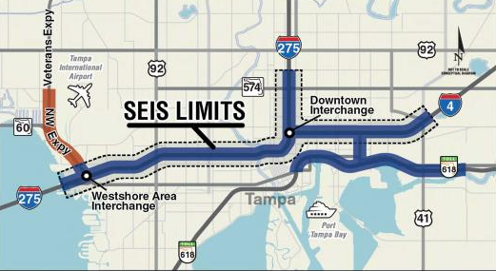

Tampa Interstate Study (TIS)
Supplemental Environmental Impact Statement (SEIS)
2
Where are we in the process?
ALL documents remain in DRAFT form
and are open for public comment until after the Public Hearing in early 2020.
We are here
SEIS Began January 2017
Public Workshop October 2017
Preparation of Documents Ongoing
Public Workshop May 2019
SEIS Public Hearing
Early 2020
Notes:
After the Supplemental EIS kicked off, FDOT hosted a public workshop in October 2017. Since then, we refined the alternatives, evaluated potential impacts, and prepared draft reports. Tonight’s workshop is a chance for you to learn more, ask questions and provide your input. We will then take that input and develop a preferred alternative that will be evaluated in more detail and presented at a public hearing in early 2020. Zone 2 provides more detail on the process.

Slide 9
Tampa Interstate Study SEIS
2
What Are We Evaluating in the SEIS?
A project’s environmental impacts, engineering considerations, and public comments aid in the decision-making process.
This graphic lists the various documents that FDOT is preparing as a part of this process.
SEIS Study Process
Sociocultural
Effects
Natural and Physical Effects
Engineering Considerations
Public
Outreach
SCE Tech Memo (includes Environmental Justice and Economic Considerations)
Cultural Resources Assessment Survey/Section 106 Case Study
Conceptual Relocation Plan
Air Quality Tech Memo
Natural Resources Evaluation
Noise Tech Memo
Contamination Screening
Preliminary Engineering
Traffic Tech Memo
Pond Siting
Public and Agency Coordination Plan
Comments and Coordination Tech Memo
Small Group Meeting
Public Workshop/Hearing
The Federal Highway Administration has environmental oversight of the Tampa Interstate Study, while FDOT’s Office of Environmental Management has oversight of the Northwest (Veterans) Expressway.
Notes:
We are undertaking a comprehensive evaluation of alternatives leading to the selection of a preferred alternative. A number of different draft documents have been prepared to date and are available for review at this Public Workshop.
They cover 4 main areas that all PD&E such as this study evaluates:
- Socialcultural Effects
- Natural and Physical Effects
- Engineering Considerations and
- Public Outreach
The Federal Highway Administration has environmental oversight of the Tampa Interstate Study, while FDOT’s Office of Environmental Management has oversight of the Northwest (Veterans) Expressway.

Slide 10
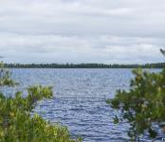
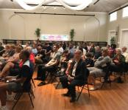
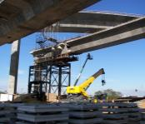
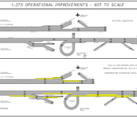
How will we ultimately make a decision?
2
SEIS Update
Environment
Constructability
Engineering and Traffic
Follow the Process
Public Comment
Balance the Issues
Balance the Issues
*No single factor outweighs all others
Notes:
So how do we select the preferred alternative? There are many factors that must be balanced in this decision. Environmental constructability, and public comments are all important considerations, but not one element serves as the deciding factor. By following the process and balancing the issues we will be able to make a good decision for all involved.

Slide 11
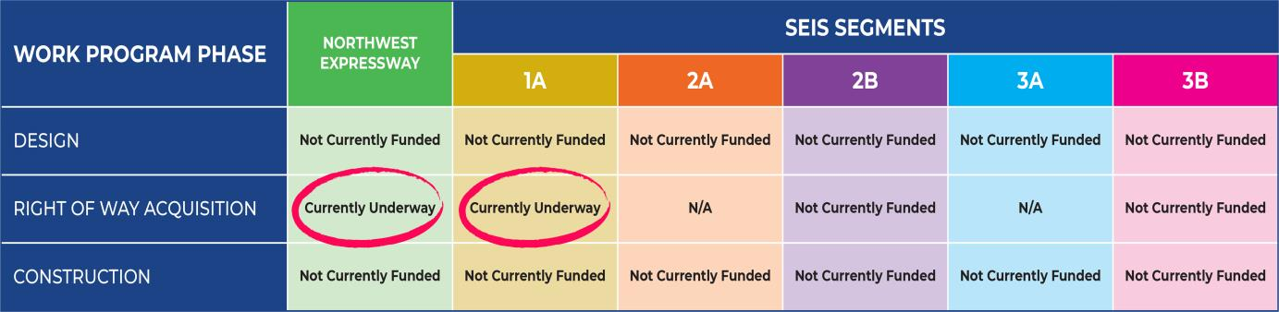
2
Fiscal Year of Funding
FDOT Current 5-Year Work Program: (FY 2019 – 2023)
The study is anticipated to be completed by Fall 2020.
Project is not currently funded with exception of ROW Acquisition for Segment 1A and Northwest Expressway.
FDOT is currently seeking funding for the selected alternative.
Notes:
It is important to note, that none of these projects currently have construction funding in the next 5 years. In the current 5-Year Work Program, Right-of-Way Acquisition for both Segment 1A (Westshore Interchange), and the Northwest Expressway are funded. FDOT is actively seeking construction funding for the Westshore Interchange.

Slide 12

3
What problems are we trying to solve?
Traffic Operations
The complete listing of the Purpose and Need for the Tampa Interstate Study
is available on the project website.
Notes:
Zone 3 addresses the questions that often arise such as “Why are we doing this?” and “What problems are we trying to solve?” The purpose and need of the Tampa Interstate Study is much the same as noted in the original study.
Traffic congestion both now and in the future can impede our ability to move people, services and goods throughout the region. Because of the urban location, the project area experiences some of the highest congestion levels in the region. This not only affects interstate users, but it can also impact mobility along the local streets for people, neighborhoods, businesses, and other aspects of normal daily life in the Tampa area.

Slide 13
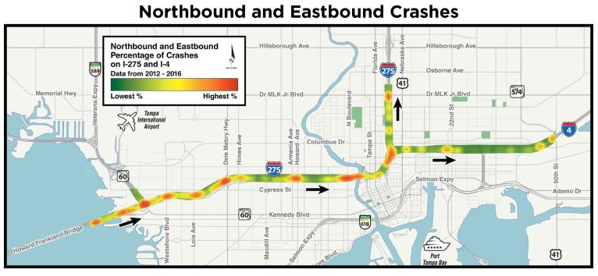
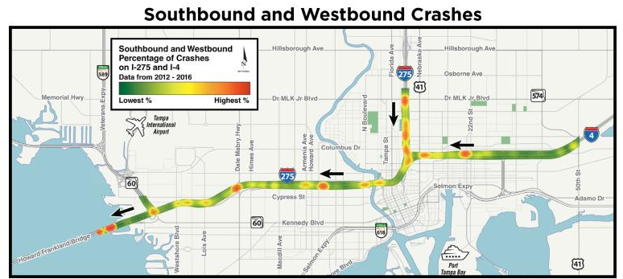
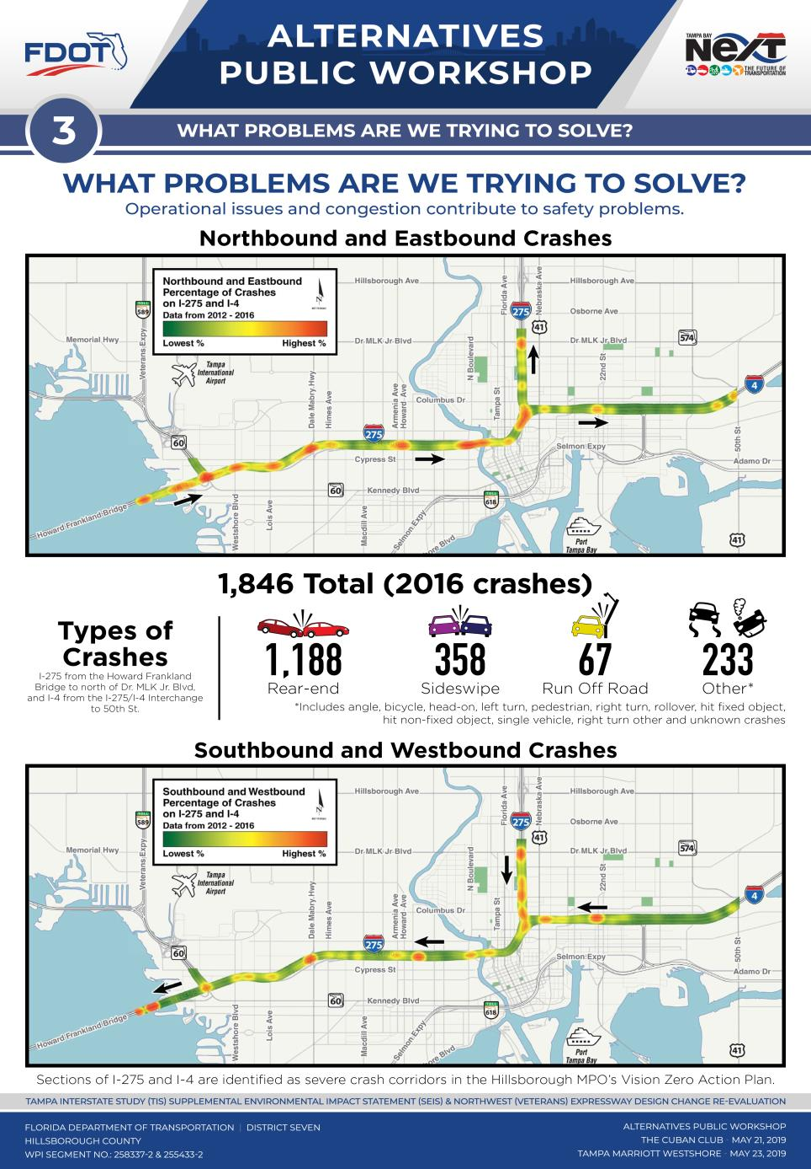

3
Purpose/Need - Safety
Sections of I-275 are identified as severe crash corridors in Hillsborough MPO’s Vision Zero Action Plan.
What Problems Are We Trying to Solve?
Operational issues and congestion contribute to safety problems.
I-275 from the Howard Frankland Bridge to N Boulevard, SR60 from
I-275 to the Veterans Expressway, and the Veterans Expressway
to Hillsborough Ave North of Memorial Highway
993 Total
(2016 crashes)
Westshore Area
Downtown Area
* Includes angle, bicycle, head-on, left turn, pedestrian, right turn, rollover, hit fixed object, hit non-fixed object, single vehicle, right turn other and unknown crashes.
Notes:
FDOT’s primary objective in any project is improving safety. During our evaluation, we looked closely at where high crash locations occur often called hot spots. This slide shows crashes between 2012 and 2016 along I-275 and I-4. Many of these problem areas, are also in areas of higher traffic congestion.

Slide 14
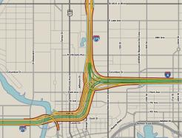
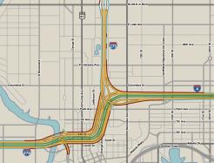
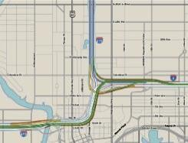
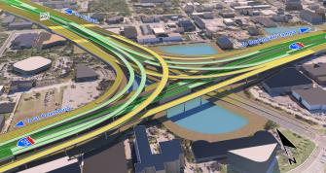
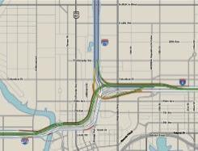
4
8
5
SEIS Update
What alternatives is FDOT considering ?
Tolled Express Lanes
A
1996 TIS FEIS Long-Term
Preferred Alternative
(Non-Tolled)
B
No
Further
Action
C
D
Westshore
Interchange
Downtown Tampa
Interchange
Notes:
To help meet the project need, project alternatives are on display tonight. They include the No Further Action Alternative, the 1996 Long Term Preferred Alternative from the original 1996 Study, and four concepts for tolled express lanes named design options A, B, C and D. Please visit Zone 8 to learn more about the project alternatives, and Zone 5 to see 3D visualizations of the tolled express lane alternatives.

Slide 15
4
Evaluation Matrix
Improves System Capacity | Delay Time (AM and PM) | General Use Lanes
 |  | Express Lanes
 |  | Projected GUL/EL
 | Average Travel Speed (AM and PM) | General Use Lanes
 |  | Express Lanes
 |  | Projected GUL/EL
Accommodates Transit Operation | Provides Express Bus/BRT Opportunities
 | Maintains Transit Corridor
 | Supports Connections to Existing and Planned Services (e.g. streetcar, circulator, multimodal)
Neighborhood Connections | Improves Existing Connections
 | Provides New Connections
Cultural Resources | Historic | Historic Buildings Directly Impacted
 | Archeological Sites* | Sites Impacted
Section 4(f) Parks and Recreational Areas | Resources Potentially Directly Impacted
Community Resources Directly Impacted | Number
Natural Resources | Wetlands/Seagrasses | Acres
 | Floodplains | Potential for Encroachment
 | Surface Waters | Acres
 | Threatened & Endangered Species | Probability of Effect (Low/Med/High)
Physical Resources | Noise Sensitive Sites
 | Contamination Sites | Number of Sites Rated High or Medium Risk
R/W Impacts | Number of Parcel Impacted/Already Purchased/Remaining to Purchase
 | Remaining Business Relocations
 | Remaining Residential Relocations
Preliminary Estimated Capital Cost (millions) | Design
 | Right-of-Way
 | Construction
 | Construction Engineering and Inspection
 | Total
Compares quantitative criteria for each alternative by segment
Will be updated as the project progresses
Notes:
As a means of comparing the alternatives, FDOT prepared a detailed evaluation matrix that shows the potential environmental impacts, such as historic resources and parks. The evaluation matrix compares differences for each alternative by segment. For more information about the preliminary study findings, please visit Zone 4.

Slide 16
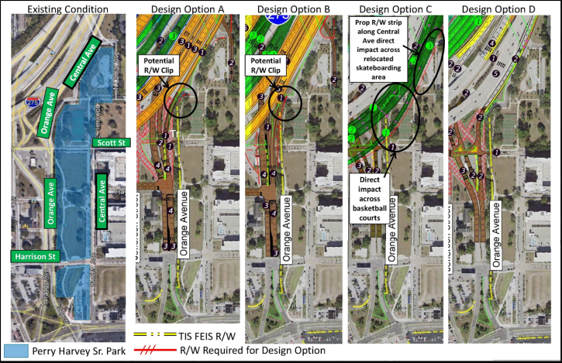
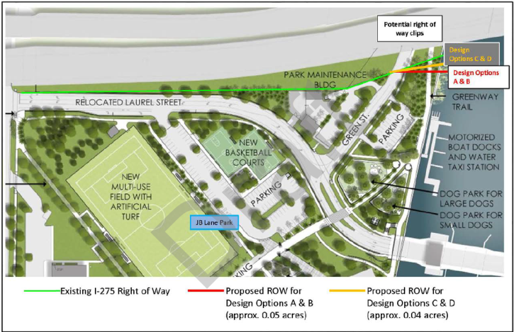
4
Potential Section 4(f) Park Impacts
Design Options A, B and C will require
property from Perry Harvey Sr. Park
All 4 Design Options will have minor impacts to a portion of Julian B. Lane Park
(See before and after image in Zone 5 for ground level views)
Notes:
There are potential impacts with design options and park properties protected under Section 4(f)
Design Options A, B and C will require acquisition of property from Perry Harvey Sr. Park with Option C requiring more than A or B. All 4 Design Options will have minor impacts to land in the far northeast portion of Julian B. Lane Park north of Laurel Street. Workshop displays and before/after images show more details of these potential impacts.

Slide 17
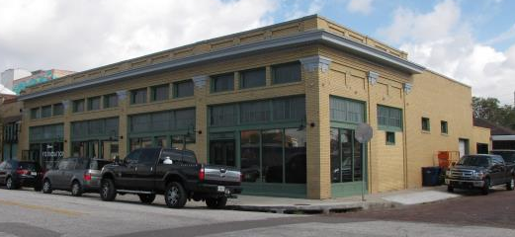
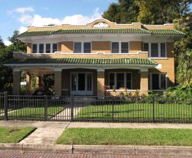
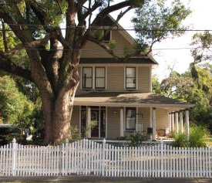
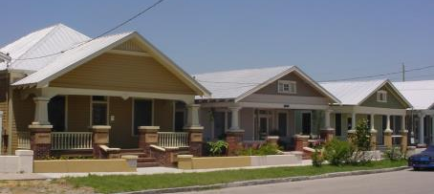
Cultural Resources Assessment Survey (CRAS) Update –
September 2018
4
Section 106 Historic Resources
Alice said: Not sure we need this
954 Historic Resources (491 newly recorded)
2 archaeological sites
5 historic districts in the Area of Potential Effects (APE)
CRAS identifies cultural resources and evaluates
National Register of Historic Places eligibility
SHPO and FHWA concurred with the CRAS in November 2018
Section 106 Case Study Report – To Be Prepared Next
Document direct and indirect effects after preferred alternative is identified
Potential direct impacts to 14 – 30 historic resources
(early estimate) depending on alternative options
Evaluate noise and visual effects
Notes:
We have completed a thorough updated assessment of historic and archaeological resources and have documented the results in a Cultural Resources Assessment Survey that has been accepted by the State Historic Preservation Officer. Additional information is available at this workshop on some of the potential effects to these resources. A more detailed effects evaluation will be prepared after selection of a preferred alternative to more definitively look at potential noise and visual effects.

Slide 18
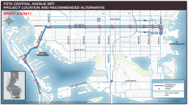
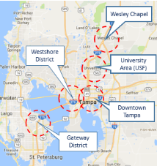
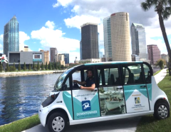
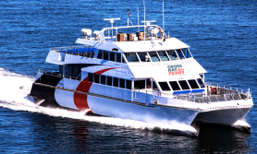

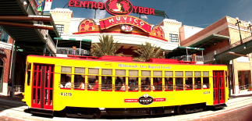
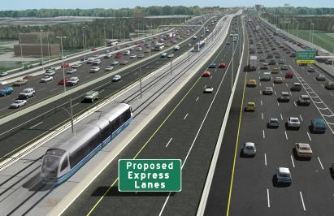
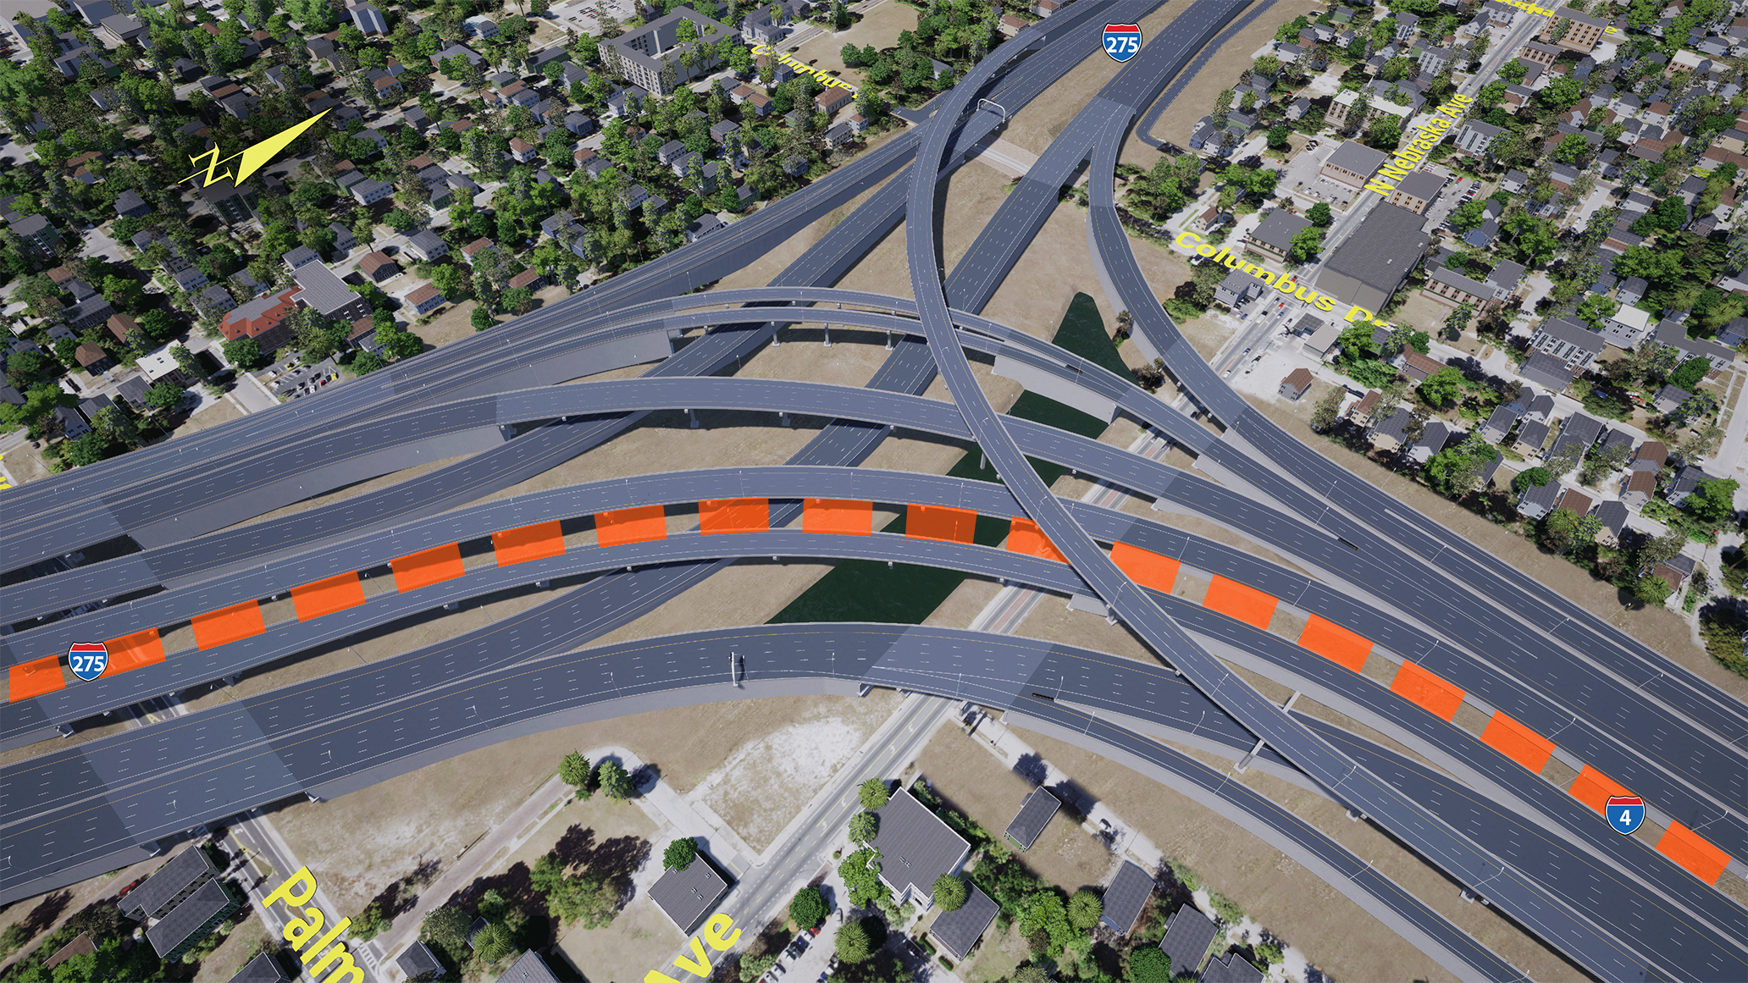

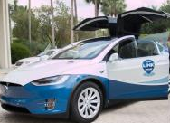
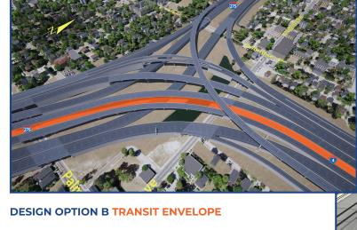
Opportunities for Connectivity & Transit
6
FDOT is a transit partner.
We’re working with local agencies to explore the best ways
to integrate transit into the program.
Intermodal Center Studies
Notes:
FDOT supports transit, from regional bus rapid transit to local streetcar. Our team is looking at the best ways to accommodate transit in the study area. Not only do the build alternatives accommodate a transit envelope, but the public transit buses can use the express lanes toll-free, which will offer a more reliable trip. In addition, FDOT is looking at hard shoulder running when the express lanes drop below a certain speed. We have purchased property in Westshore for a transit center, and purchased some property for a downtown transit center. Please visit Zone 6 for more information on transit and multimodal connectivity.

Slide 19
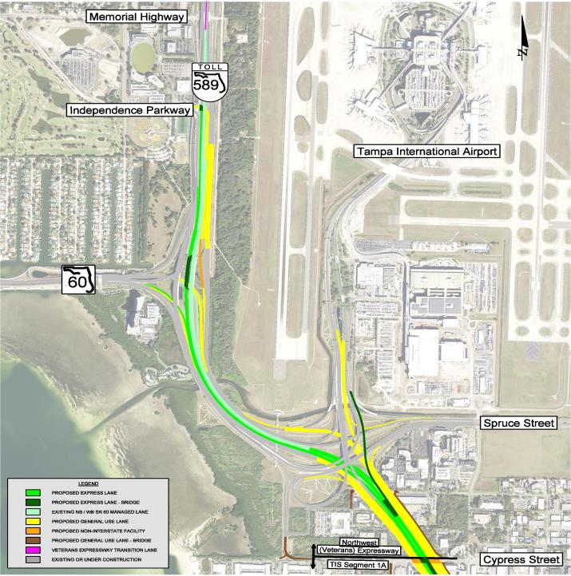
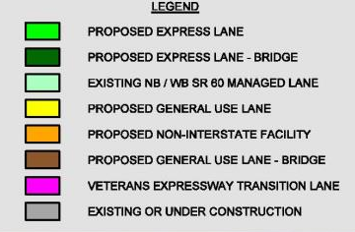
Northwest (Veterans) Expressway
7
SR 60 / Memorial Highway from North of Cypress Street to North
of Memorial Highway
A separate environmental study
Connecting the express lane system from I-275 to the Veterans Expressway and the direct express lane connection to the Tampa International Airport.
Right-of-Way is required for this project.
DRAFT
5/21/19
Notes:
This workshop also includes information regarding the Northwest Expressway Design Change Re-evaluation, that runs from north of Cypress Street to north of Memorial Highway. This is a separate environmental study that is evaluating the impacts of connecting the express lane system from I-275 to the Veterans Expressway, and the direct express lane connection to Tampa International Airport. Right of way is required for this project. Please visit Zone 7 for more information.

Slide 20
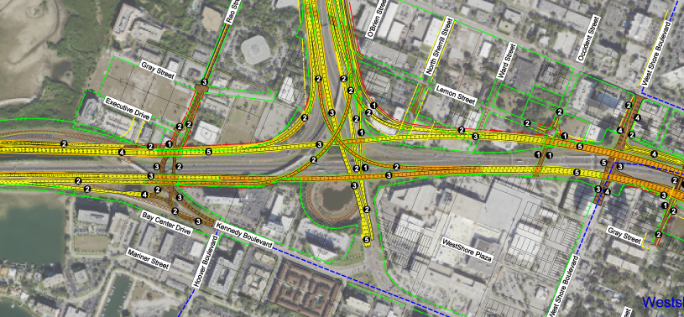
No Further Action Alternative
8
FDOT received Records
of Decision (ROD) in 1997
and 1999 to build segments
of the TIS.
FDOT has built many approved segments over the past 20 years.
No Further Action represents
“No Build” throughout the study corridor, except the Westshore Interchange where FHWA approved widening of the
outside lanes in 1999.
FDOT received Records
of Decision (ROD) in 1997
and 1999 to build segments
of the TIS.
FDOT has built many
approved segments over
the past 20 years.
No Further Action to remain
viable throughout the study
but does not meet
purpose and need.
“No Further Action” rather than
“No Build” because FDOT has already built numerous segments throughout the past 20 years
Represents “No Build” everywhere, except for the Westshore Interchange, where the outer roadways were approved by
FHWA in 1999
Must remain viable throughout the study, but does not meet purpose and need
DRAFT: 5/21/19
No Further Action
Notes:
We will give you a brief overview of the different alternatives shown in more detail in Zone 8. The “No Further Action Alternative” term is being used because we have already built several portions of the original approved project. The only area that we haven’t built that was already approved by FHWA is the outer roadways of the Westshore Interchange. Widening of this interchange was approved in previous records of decision. Everywhere else “No Further Action” actually means “No Build”.

Slide 21
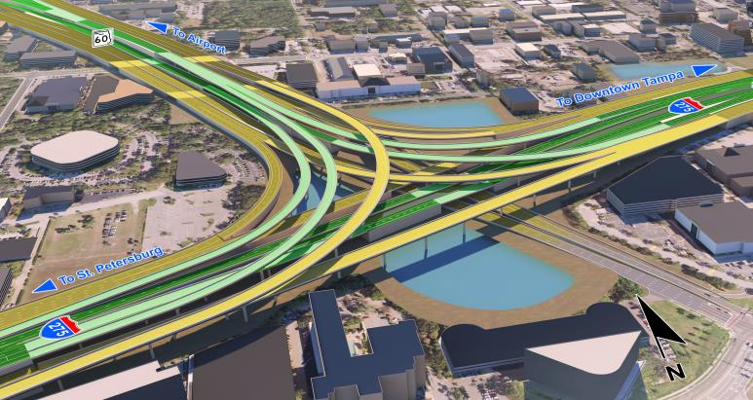
8
Tolled Express Lanes
Segment 1A
Reconstructs I-275/SR 60 Interchange
Adds 2 tolled express lanes in each direction (shaded in green)
Connects express lanes on Veterans and Howard Frankland Bridge
Direct express lane connection to Tampa International Airport
New underpasses at Reo, Occident, and Trask Streets
Express lane access at Reo and Himes
Provides transit envelope on I-275
15 additional parcels needed
Total Construction Cost: $1.1 Billion
I-275/SR 60 - Westshore Interchange
Reconstructs I-275/SR 60 Interchange
Adds 2 tolled express lanes in each direction (shaded in green)
Connects express lanes on Veterans
and Howard Frankland Bridge
Direct express lane connection to Tampa International Airport
Dedicated ramp from Kennedy Blvd.
to Tampa International Airport
Express lane access at Reo Street
and Himes Avenue
Preserves transit envelope in median
of I-275
DRAFT: 5/21/19
Express Lanes
General Purpose Lanes
Proposed Design
Notes:
Now we will briefly walk you through the tolled express lane alternatives. Segment 1A includes reconstruction of the Westshore Interchange and adding 2 tolled express lanes in each direction that will join express lanes to be constructed on the Howard Frankland Bridge under a different project. There would be connections to the Veterans Expressway and Tampa International Airport. The FDOT is actively seeking funding to construct the Westshore Interchange. Improving the Westshore Interchange is a priority to relieving the traffic bottleneck in this area.

Slide 22
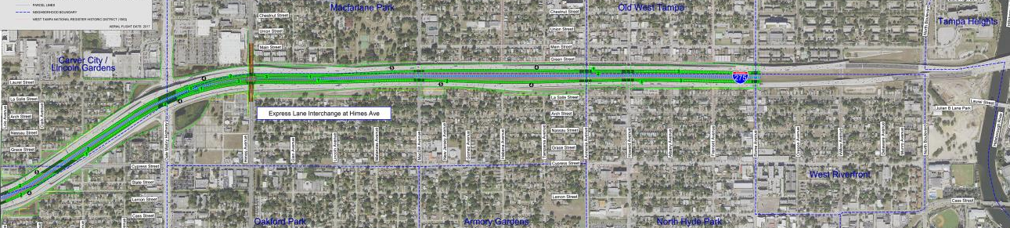
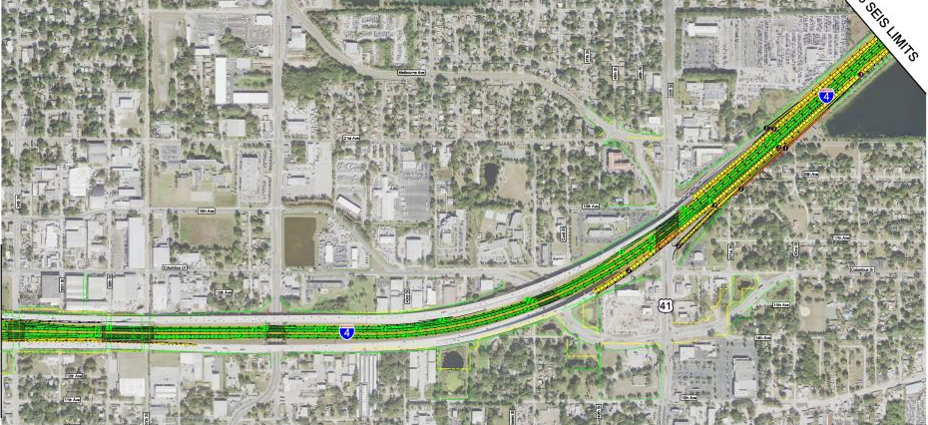
Segment 2A - West Tampa Improvements
8
Tolled Express Lanes
Segments 2A & 3B
No Right of Way
DRAFT 5/21/19
Segment 3B –
I-4 East of Selmon Connector ->
Minor Right of Way
DRAFT 5/21/19
22
Notes:
In Segment 2A, I-275 between Westshore and downtown, and in Segment 3B, I-4 east of 34th Street, the outer roadways have already been built, so the express lanes and transit envelope is accommodated in the median. Direct express lane access would be provided from the Westshore area at Himes. No right of way is needed in Segment 2A. In Segment 3B, along I-4, minor right of way is needed along the south side of the 50th Street on-ramp.

Slide 23
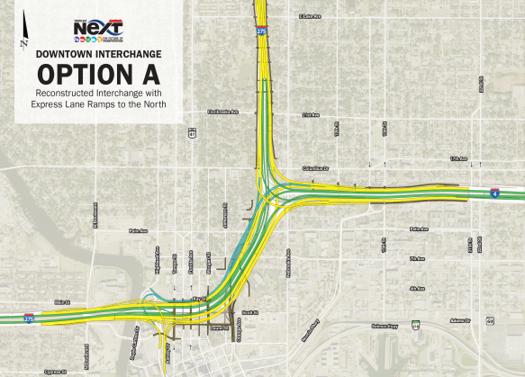
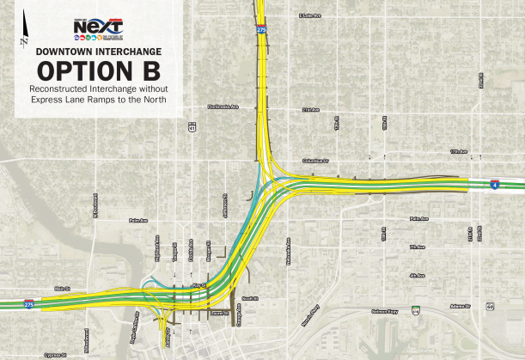
8
Tolled Express Lanes
Segments 2B & 3A
I-275/I-4 - Downtown Interchange
DRAFT 5/21/19
DRAFT 5/21/19
Includes a connection from the express lanes to the general purpose lanes on I-275 north.
Elements related to Options A & B:
Adds 2 tolled express lanes
in each direction
Reconstructs I-275 and I-4
Largest footprints
(190 – 220 parcels)
Fixes existing geometric issues (include I-275 ramp to I-4)
Opportunities to reconstruct underpasses
Opportunities for public realm improvements at Robles Park, Downtown Tampa, and Julian B.
Lane Park
Accommodates transit envelope
in the median
Notes:
Segments 2B and 3A include the heart of the downtown interchange. There are 4 different options under consideration. Options A and B are similar in that they would reconstruct I-275 and I-4 and add two to three express lanes in each direction (shown in green). These options would remove some of the roller-coaster effect, widen the shoulders, reconstruct the underpasses, and provide for a transit envelope. The main difference between Options A and B is Option A includes a connection from the express lanes to the general purpose lanes on I-275 north, but Option B does not. These options have a larger footprint than the other 2 design options.

Slide 24
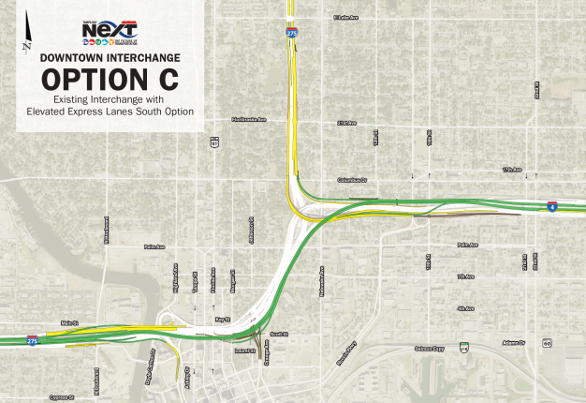
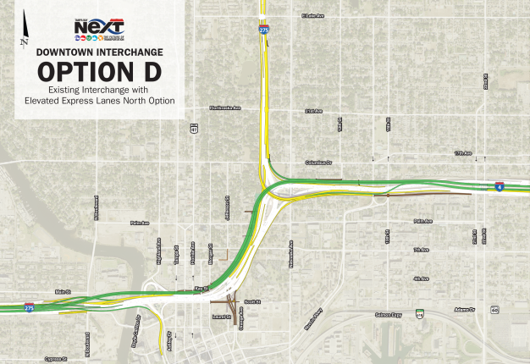
8
5
Tolled Express Lanes
Segments 2B & 3A
I-275/I-4 - Downtown Interchange
DRAFT 5/21/19
DRAFT 5/21/19
The express lanes
(shown in green) would be built to the north and west of the existing lanes.
The express lanes
(shown in green) would be built to the south and east of the existing lanes.
Elements related to Options C & D:
Adds 2 tolled express lanes
in each direction via a viaduct alongside the existing interstate
Smallest footprints
(64-75 parcels)
Fixes Southbound I-275 ramp to I-4
Does not fix other existing geometric issues
Opportunities to retrofit underpasses
Fixed-guideway transit
would be a challenge
Notes:
Options C and D do not reconstruct the existing interstate, rather they add two express lanes on an elevated structure (called a vi/a/duct) next to the existing structure. The other 2 design options both require a smaller footprint. In Option C, the express lanes (shown in green) would be built to the south and east of the existing lanes, while in Option D, they would be built to the north and west of the existing lanes. There would be no direct access from the north leg of I-275 into the express lanes in either of these options. Accommodating a transit envelope would be more challenging with these options as there is no space in the median for it. All 4 options provide direct access to express lanes from downtown and upgrade the I-275 South to I-4 east flyover to 2 lanes. The FDOT is not actively seeking construction funding in the downtown area. For more information, visit Zones 5 and 8.

Slide 25
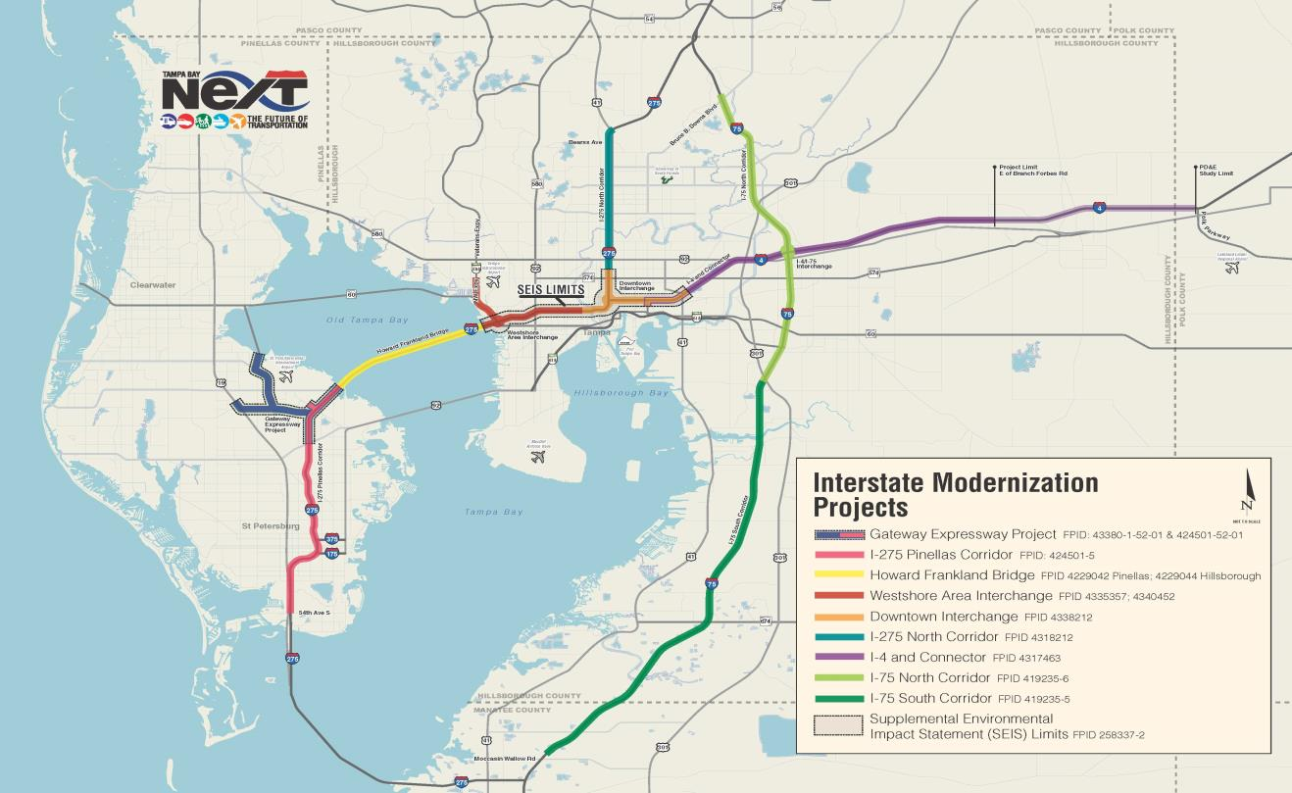
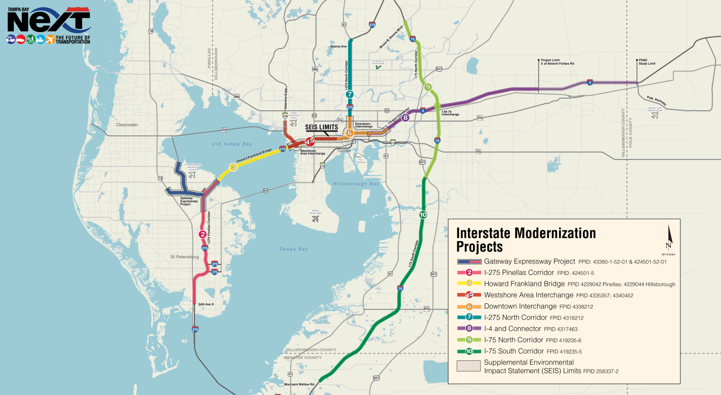

9
Tampa Bay Next Program
Notes:
Both of these projects shown tonight are part of a larger collection of interstate modernization projects along I-275, I-4 and I-75 in the Tampa Bay Next program. With Tampa Bay Next, the FDOT is also looking at how potential transit, bicycle/pedestrian safety, freight mobility, and smart cities can improve mobility in the Tampa Bay region.

Slide 26



Opportunities for Input
Ask Questions and Offer Comments
Notes:
At this time, we encourage you to view the displays in the exhibit hall and engage with our staff who can help you better understand this complex project and answer your questions.

Slide 27


Opportunities for Input
Multiple Ways to
Provide Comments
  Drop comment form in box
  Comment form by mail or email
  Submit a comment from the comments page
  on project website www.tampainterstatestudy.com
Florida Department of Transportation – District Seven
11201 N. Malcolm McKinley Drive, MS 7-500
Tampa, FL 33612
Must be postmarked by
June 6, 2019
to become part of the official public workshop record
Notes:
There are several ways to make a comment as part of the public workshop. All comments received, will be reviewed and considered in the final recommendation.
To provide comments:
You may complete the Comment Form provided to you and drop it in one of the comment boxes today;
You may mail written comments to the address listed on the back of the form.
Or You may input comments onto the comment page of the project website.
Please make sure comments mailed are postmarked by June 6 to become part of the official public workshop record.

Slide 28

Thank you for Participating!
For Additional Information Please Contact:
Also feel free to visit
www.tampaInterstatestudy.com
For more information on adjacent projects refer to: www.TampaBayNext.com
Notes:
We thank you for taking time out of your day today to participate in this public workshop. Your input is valuable to us. Please proceed into the main exhibit hall to view the materials on display and speak with FDOT staff.

Slide 29
Please take time to view the exhibits on the 4th Floor and provide us your comments.
The video will repeat
in 1 minute

Slide 30
Please take time to view the exhibits in the Main Area and provide us your comments.
The video will repeat
in 30 seconds

Slide 31
Please take time to view the exhibits in the Main Area and provide us your comments.
The video will repeat
in 10 seconds

Slide 32
Please take time to view the exhibits in the Main Area and provide us your comments.
The video will repeat
in 5 seconds

